Slide 1


Slide 2

www.soencouragement.org
barringtonbrennen@gmail.com
1-242-477-4002
Cell and WhatsApp

Slide 4


Slide 5
Am I ready to say
Yes,
I do.

Slide 6
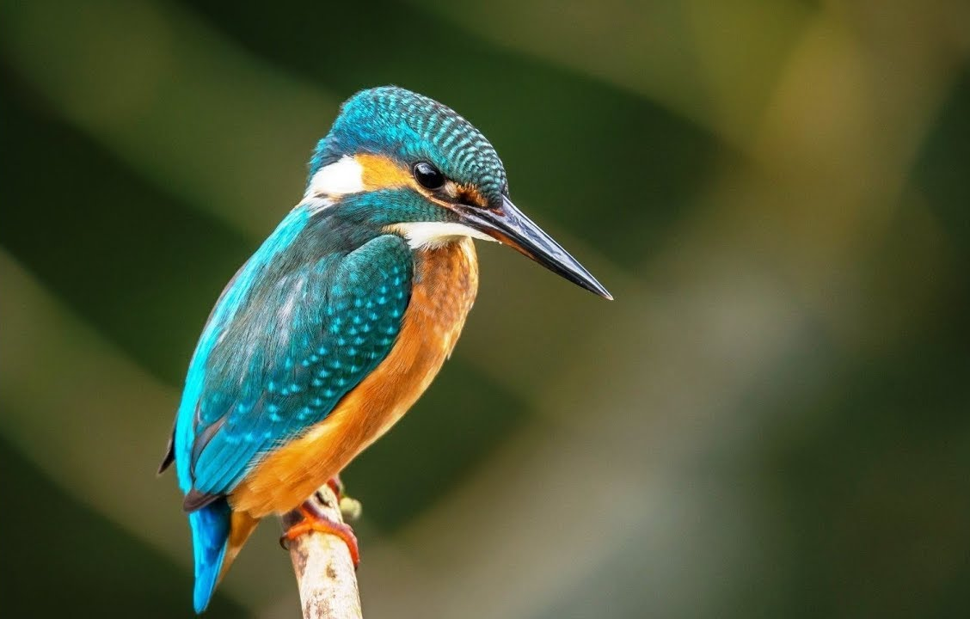
Am I ready to say
Yes,
I do.

Slide 7

Am I ready to say
Yes,
I do.

Slide 8
Am I ready to say
Yes,
I do.

Slide 9
What makes one ready for marriage?
Age?
Maturity?
Education?
Spiritual standing?
Intelligence?
Accumulation of money?
Owning property?
Am I ready to say
Yes,
I do.

Slide 10
What makes one ready for marriage?
Am I ready to say
Is it whether your parents will let you get married or force you to get married.
Yes,
I do.

Slide 11
What makes one ready for marriage?
Am I ready to say
Your readiness to say, “I do,” has nothing to do with finding the right person. It is all about being the right person.
Yes,
I do.

Slide 12
What makes one ready for marriage?
Am I ready to say
Pressure from the church, family, and tradition.
Yes,
I do.

Slide 13
Am I ready to say
Yes,
I do.

Slide 14
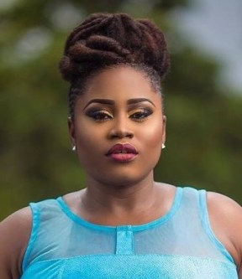
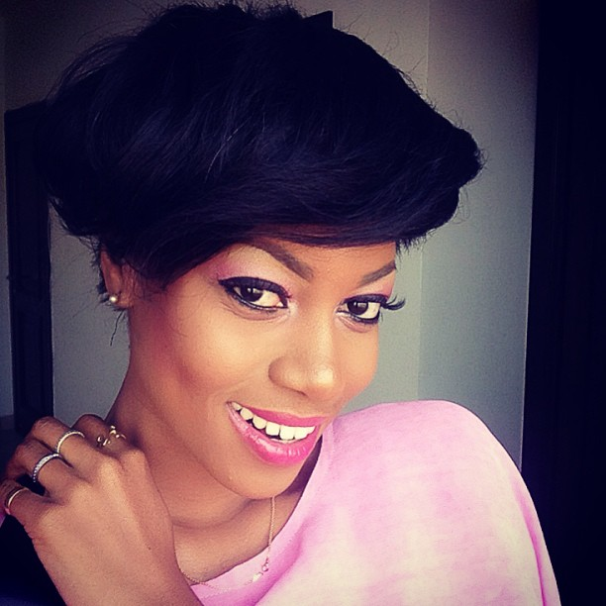
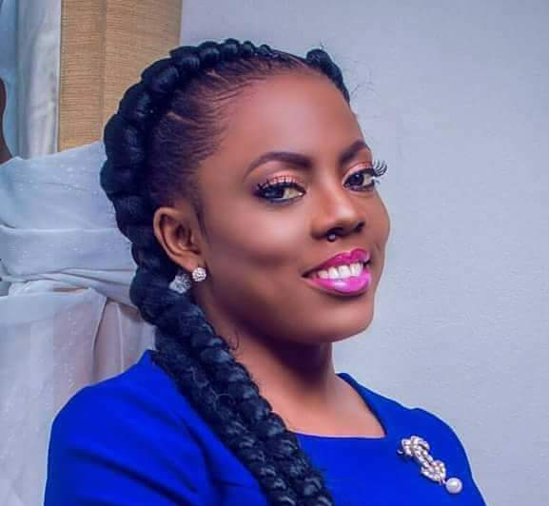
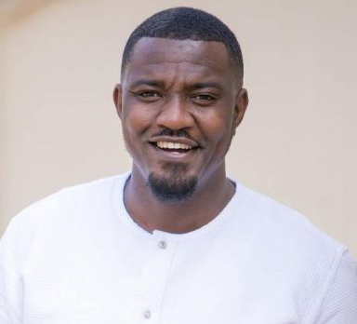
Pressure
to get married.

Slide 15
Ghana Population 2018
45% of all men are married
57% of all women are married
51% of men not married
33% of women not married

Slide 16
Important Points
Marriage does not make you happy. It only makes you married. Happy people make happy marriages
Marriage is not a requirement for salvation.
Marriage is not a requirement for healthy mental and social wellbeing.
People who get married too young or too soon in life, rob themselves of healthy emotional, intellectual, and social development. And is some case may even impact physical development or cause long-term health issues.

Slide 17
Don’t think . . .
Don’t think that marriage is the answer to all your problems.
Don’t think that marriage will naturally bring you closer to God.
Don’t think that marriage will make you a better person.
Don’t think that marriage will automatically fulfill your dreams.

Slide 18
Ghana and The Bahamas
Legal age to vote and to drive an automobile: 18
Legal age for sexual consent: 16
Which one really requires greater responsibility?

Slide 19
Know that you are created in God’s image.
Be comfortable with who you are.
Be happy with who you are.
_________________________
The Foundation

Slide 20
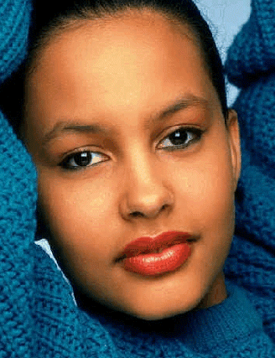
"God made me complete, unique, special, and with a purpose."

Slide 21
GOD’S
IMAGE

Slide 22
Genesis 1:26-28
26 Then God said, “Let us make human beings in our image, to be like us. They will reign over the fish in the sea, the birds in the sky, the livestock, all the wild animals on the earth, and the small animals that scurry along the ground.”

Slide 23
Both male and female
Genesis 1:26-28
26 Then God said, “Let us make human beings in our image, to be like us. They will reign over the fish in the sea, the birds in the sky, the livestock, all the wild animals on the earth, and the small animals that scurry along the ground.”

Slide 24
Both male and female
Genesis 1:26-27
26 Then God said, “Let us make human beings in our image, to be like us. They will reign over the fish in the sea, the birds in the sky, the livestock, all the wild animals on the earth, and the small animals that scurry along the ground.”
In charge.
Labor.

Slide 25
Genesis 1:26-28
27 So God created human beings in his own image. In the image of God he created them; male and female he created them.

Slide 26
Genesis 1:26-28
28 Then God blessed them and said, “Be fruitful and multiply. Fill the earth and govern it. Reign over the fish in the sea, the birds in the sky, and all the animals that scurry along the ground.”

Slide 27
Genesis 1:26-28
God gave them equal voice, power, vote, access, opportunity
28 Then God blessed them and said, “Be fruitful and multiply. Fill the earth and govern it. Reign over the fish in the sea, the birds in the sky, and all the animals that scurry along the ground.”

Slide 28

Note that to be in God’s image one need not have sex. The first description of Adam and Eve was their involvement in labor and sex.

Slide 29
In other words, the completeness of the final product of God’s creation (humans) is not made possible in the sex act, but is a matter of fact how God made us.

Slide 30
"God made me complete, unique, special, and with a purpose."

Slide 31
We are all made in God’s image.
That is what gender equality is all about.

Slide 32
BE
COMFORTABLE
WITH WHO YOU ARE

Slide 33
Matthew 22:39
“And a second is like it: You shall love your neighbor as [you do] yourself.”

Slide 34
BE
HAPPY
WITH WHO YOU ARE

Slide 35

John Powell in his book "The Secret of Staying in Love" page 13
"There is one need so fundamental and so essential that if it is met, everything else will almost certainly harmonize in a general sense of well-being. When this need is properly nourished, the whole human organism will be healthy, and the person will be happy. . . .

Slide 36
John Powell in his book "The Secret of Staying in Love" page 13
. . . This need is a true and deep appreciation for oneself, a genuine and joyful self-acceptance, an authentic self-esteem, which results in an interior sense of celebration: It's good to be me . . . I am very happy to be me!"

Slide 37
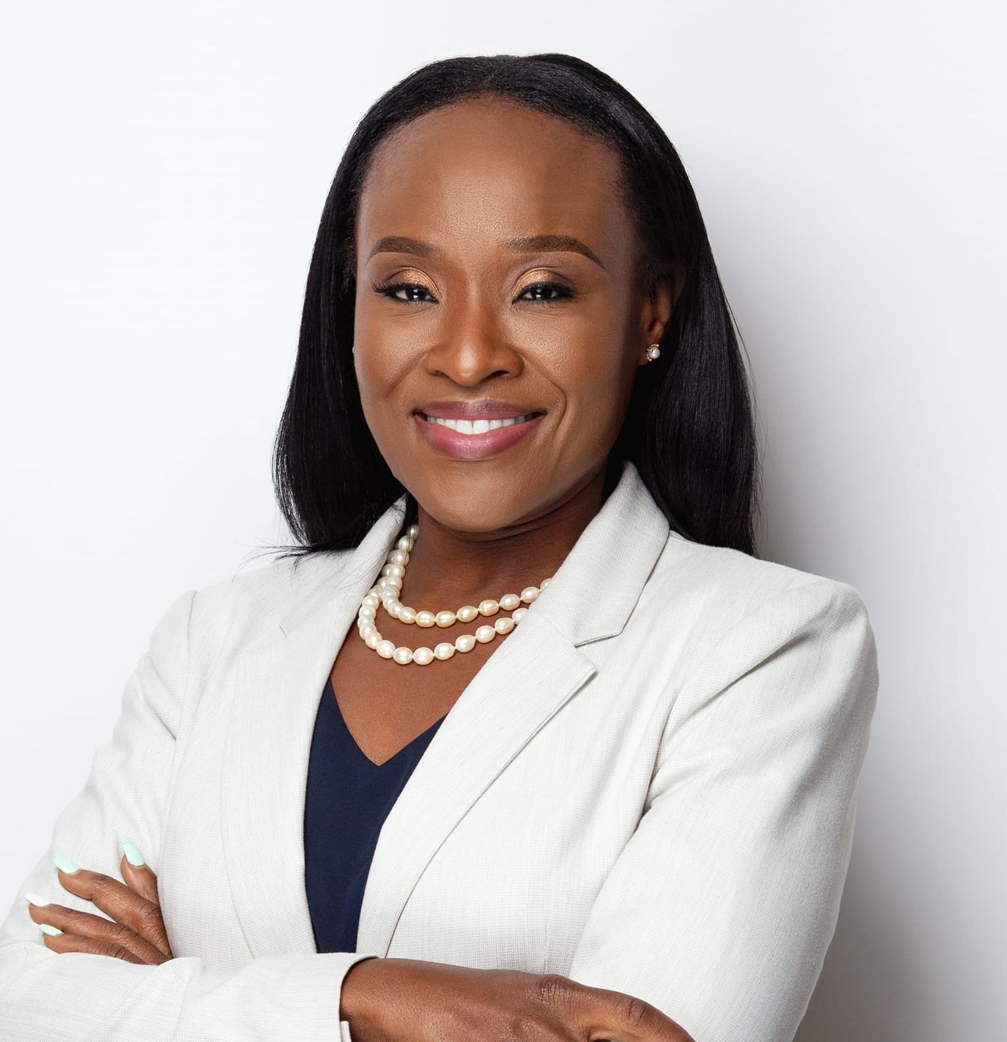
4 Wisdom Principles for healthy relationships

Slide 38
“Honey, I want to love me before I love you.”
Wisdom Principle 1

Slide 39
“Honey, I want to love Jesus before I love you.”
Wisdom Principle 2

Slide 40
“Honey, I don’t need you to be me because God made me who I am.”
Wisdom Principle 3

Slide 41
“If you cannot live without me, then I do not want you in my life.”
Wisdom Principle 4

Slide 42
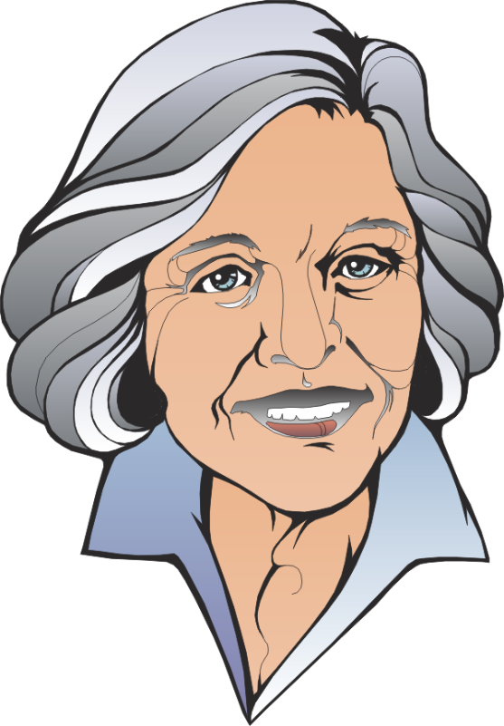
There is pressure to get married but not equal pressure to have a meaningful relationship.

Slide 43
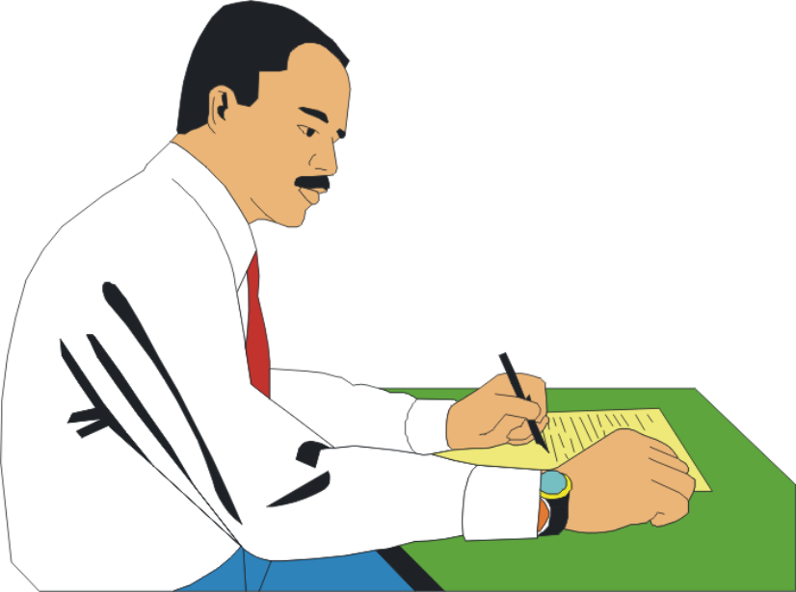
There is pressure to get married but not equal pressure to have a meaningful relationship.

Slide 44
“A situationship is not healthy in the long run. In many cases someone gets hurt emotionally. It is perhaps like “friends with benefits” but you are not really friends.”
Situationship
“A situationship can be defined as a romantic relationship that lacks commitment and the associated norms and expectations"

Slide 45
Situationship
“It is people having a reason to get together but no reason to commit to each other"

Slide 46

Dating puts you out of circulation.

Slide 47
“Dating too early in life can rob you of youthful enjoyment, healthy emotional and intellectual development.”

Slide 48
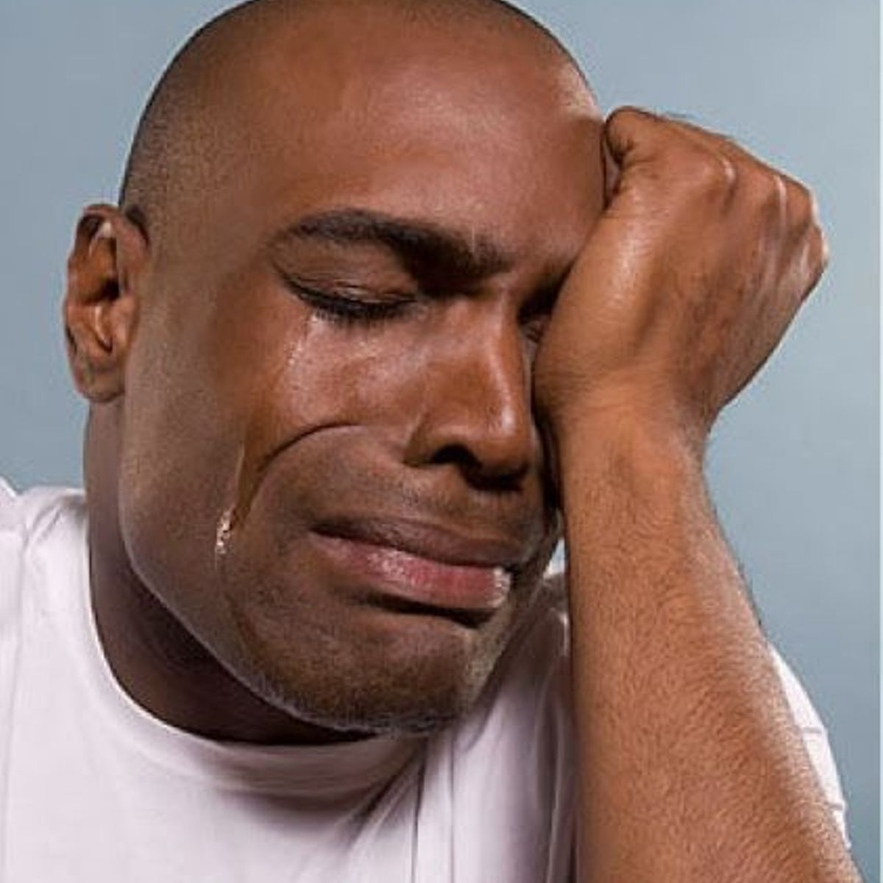
Thus, you are being hit on two sides when you are pressured to get married: You are forced in a situationship, and you are put out of circulation.

Slide 49


Slide 50
Here’s another challenge

Slide 51

DECISIONS
CHOICES

Slide 52
THINK
Wrong
First
Your
In life, You have three decisions to make
God
Life partner
Career
God
Career
Life partner

Slide 53
THINK
First
Your
In life, You have three decisions to make
Spiritual direction
Service or Occupational direction
Social direction

Slide 54
THINK
First
Your
In life, You have three decisions to make
Spiritual direction:
Are you going to be a real or fake Christian?

Slide 55
THINK
First
Your
In life, You have three decisions to make
Occupational direction:
Will you be honest, diligent, productive, on time to work.

Slide 56
THINK
First
Your
In life, You have three decisions to make
Social direction:
If you remain single or married, will you be a cheater or sexually pure? Will you use drugs?

Slide 57

Spiritual direction
If you do not have a spiritual direction, you will increase your chances of being confused, troubled and messed up. You will be more inclined to either be a religious fanatic or spiritually cold.

Slide 58

Occupation direction
If you choose not to be a person of dignity and authenticity, when you choose a job, you will increase your chances of stealing from the boss or lying.

Slide 59
Social direction
If you choose to be dictated to by your peers or social media, you will increase you chances of being a sexual pervert/addict, drunkard or drug addict.

Slide 60
Further explanation
Your spiritual direction Who and what will be your God:
    Will you be judgmental, self-righteous, or humble, and forgiving.
Your service direction Your career and how you will live:
    Will you be honest, authentic, humble, teachable, or dishonest, and not dependable.
﻿Your social direction Single or married:
    Will you be a lover boy/girl, emotional and sexually pure, or promiscuous, and cunning, etc.

Slide 61

There is pressure all around you.

Slide 62
MANY ARE DEALING WITH . . .
THUS, MANY ARE . . .
Overload of information from social media
Bombardment of sexual messages
Masturbation
Pornography
Pre-marital sex
Drugs
Alcohol
Broken/dysfunctional homes
Sexual molestation
Rape
Living in a dysfunctional home
Witnessing parents brutally fight
Lack of food
No place to study peacefully
No place to do homework
Being bullied, by family, friends, school and church mates, or neighbors
Cutting themselves to release their anger/pain
Eating non-digestible material (Pica)—chalk, hair, feces, dirt, paper, etc.
Having suicidal thoughts
Not satisfied with the weight: bulimia and anorexia nervosa
Attempting suicide
Drinking alcohol to drown their pain
Smoking cigarettes
Using marijuana/cocaine to ease their minds
Getting pregnant knowing they can have an abortion
Running away from home in search for peace and happiness
Faking being righteous and holy

Slide 63
Know that you are created in God’s image.
Be comfortable with who you are.
Be happy with who you are.
_________________________
The Foundation

Slide 64
Strive to be happy with who you are.

Slide 65
Cherish being a virgin.

Slide 66
With sexual purity, virginity is never lost.

Slide 67

Virginity offered as a loving gift to your partner in marriage.

Slide 68
Protect your heart.

Slide 69


Slide 70
www.soencouragement.org
barringtonbrennen@gmail.com
1-242-477-4002
Cell and WhatsApp

