Slide 1
Our
Dearest
Mothers

Slide 2
Faith of Our Mothers
By Arthur Bardwell Patten in 1920
To the tune of “Faith of Our Fathers”

Slide 3
1
Faith of our mothers, living yet
In cradle song and bedtime prayer,
In nurs'ry love and fireside love,
Thy presence still pervades the air:
Faith of our mothers, living faith,
We will be true to thee till death.

Slide 4
2
Faith of our mothers, lavish faith,
The fount of childhood's trust and grace,
O may thy consecration prove
The well-spring of a nobler race:
Faith of our mothers, lavish faith,
We will be true to thee till death.

Slide 5
3
Faith of our mothers, guiding faith,
For youthful longing--youthful doubt,
How blurred our vision, blind our way,
Thy providential care without:
Faith of our mothers, guiding faith,
We will be true to thee till death.

Slide 6
4
Faith of our mothers, Christian faith,
In truth beyond our man-made creeds,
Still serve the home and save the church,
And breathe thy spirit through our deeds:
Faith of our mothers, Christian faith,
We will be true to thee till death.

Slide 7
Our
Dearest
Mothers

Slide 8
Mother
MOM / MUMMY
MAMA / MAMMY / MA

Slide 9



Mothers are Special

Slide 10
Genette Perry

Slide 11

Happy
Mother’s
Day
Property manager and
Logistics Coordinator

Slide 12

Happy
Mother’s
Day
Musician
Peace Maker

Slide 13
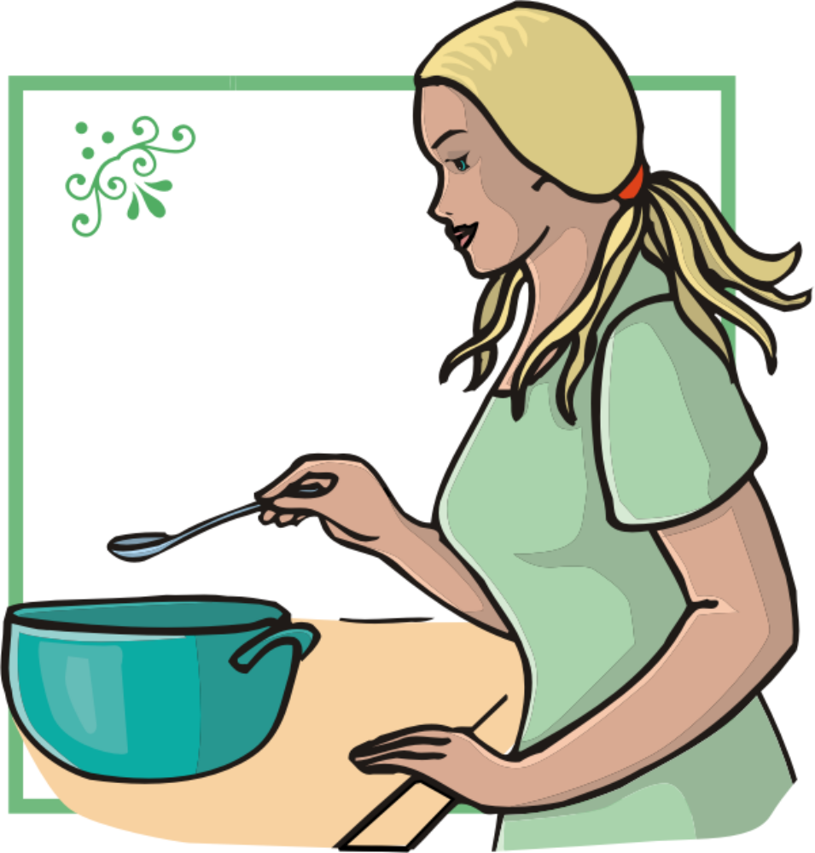
Happy
Mother’s
Day
Chef, Kitchen Curator,
Food manager

Slide 14
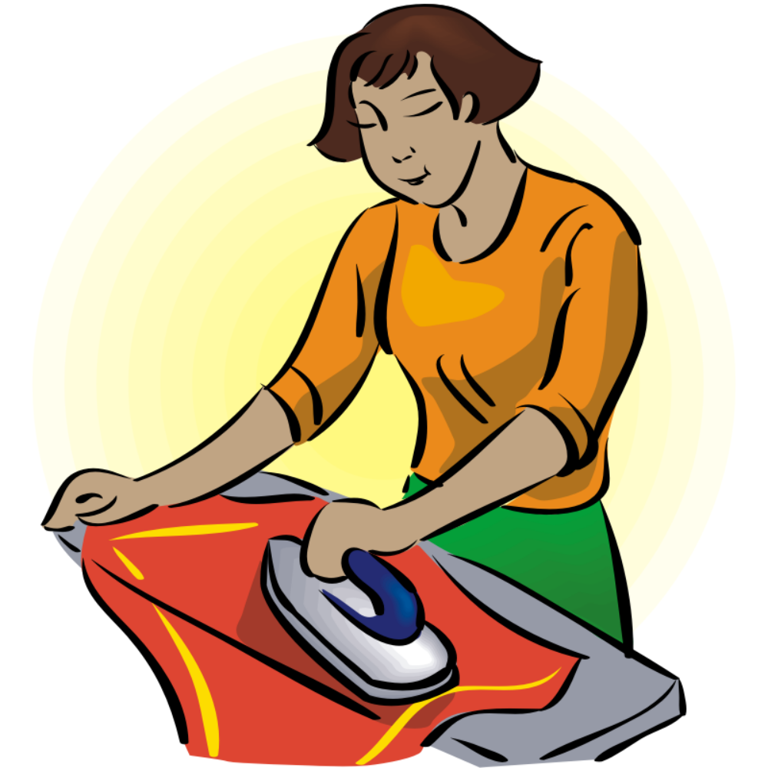
Happy
Mother’s
Day
Clothes manager

Slide 15
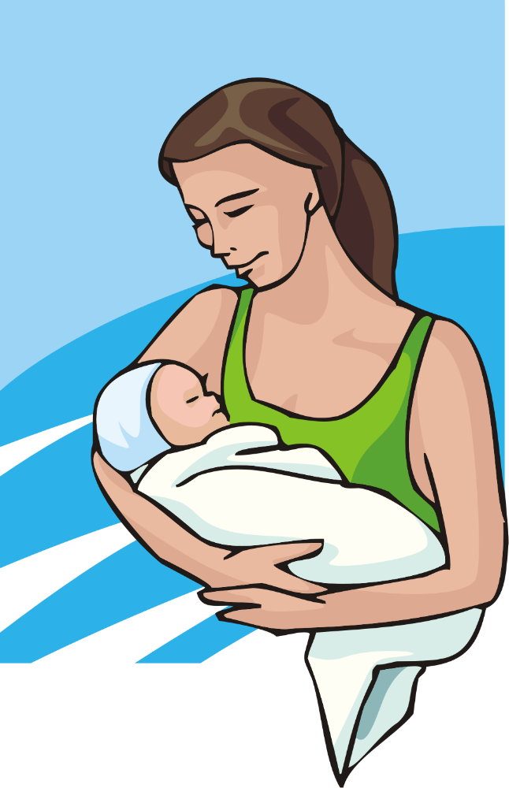
Happy
Mother’s
Day
Comforter, Psychologist,
Nurse, Physician

Slide 16

Happy
Mother’s
Day
Executive, Supervisor
Manager

Slide 17

Happy
Mother’s
Day
Idea Creator, Disciplinarian

Slide 18

Happy
Mother’s
Day
Thinker, Producer

Slide 19

Happy
Mother’s
Day
Organizer

Slide 20
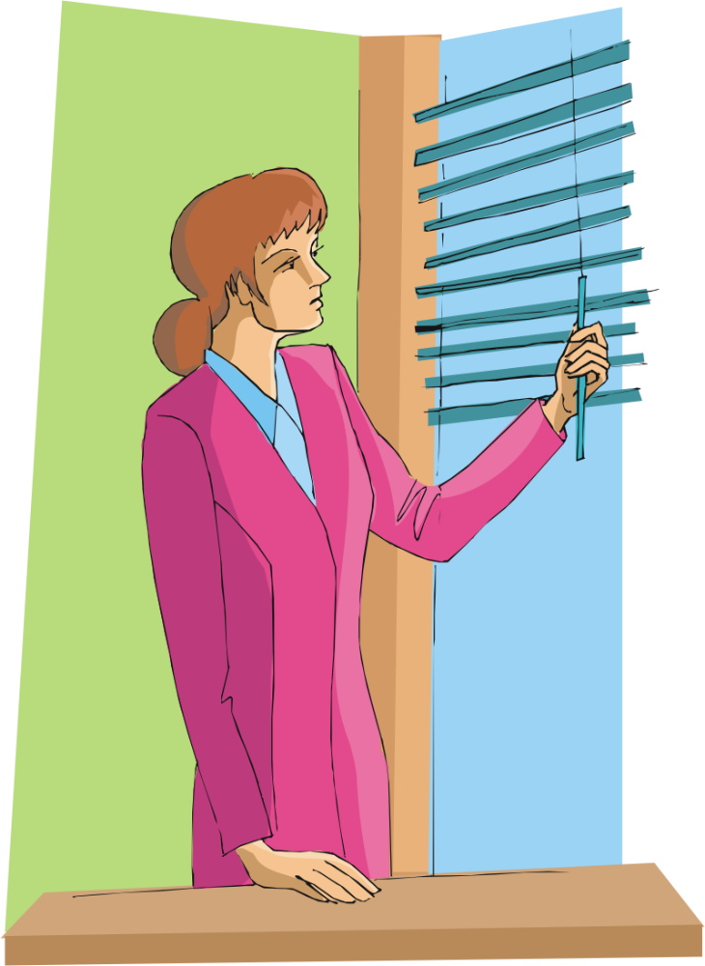
Happy
Mother’s
Day
Everything

Slide 21
Mothers are
Priceless

Slide 22
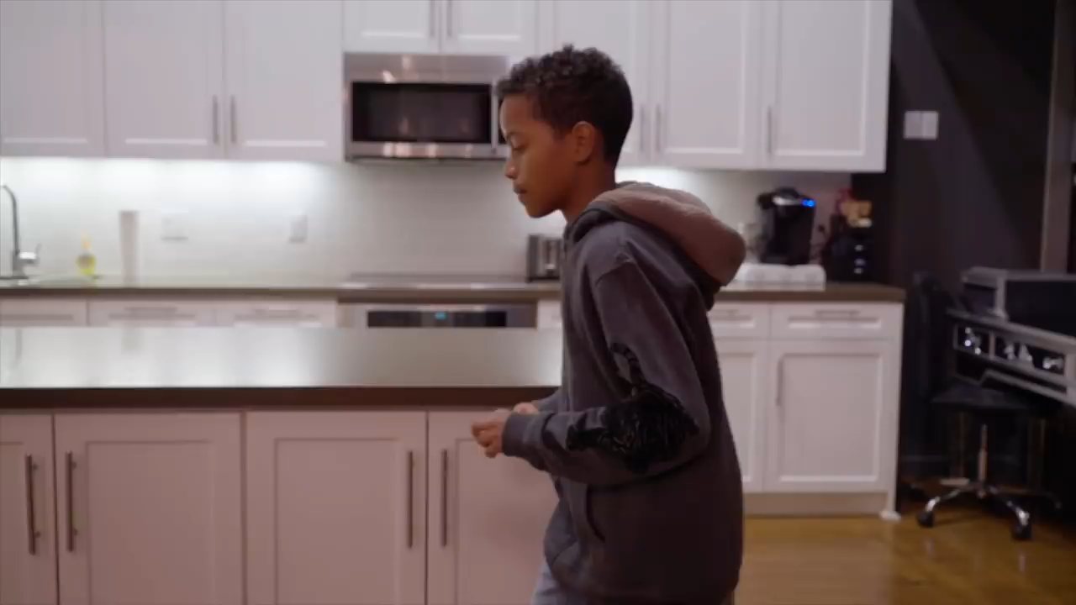

Slide 23
Mothers are
Priceless

Slide 24
Kinds of mothers
Single Mothers
Married Mothers
Divorced Mothers
Separated Mothers
Widowed Mothers
They are all mothers.

Slide 25
state of mothers
Childless Mothers
Mothers with Children
Grandmothers
Great grandmothers
Adopted Mothers
Church mothers
Neighborhood Mothers
They are all mothers.

Slide 26
“The meaning of being a mother is virtually endless. A mother is a protector, disciplinarian and friend. A mother is a selfless, loving human who must sacrifice many of their wants and needs for the wants and needs of their children. . .

Slide 27
. . . Being a mother is perhaps the hardest, most rewarding job a woman will ever experience.”
SUSAN DIRANIAN

Slide 28
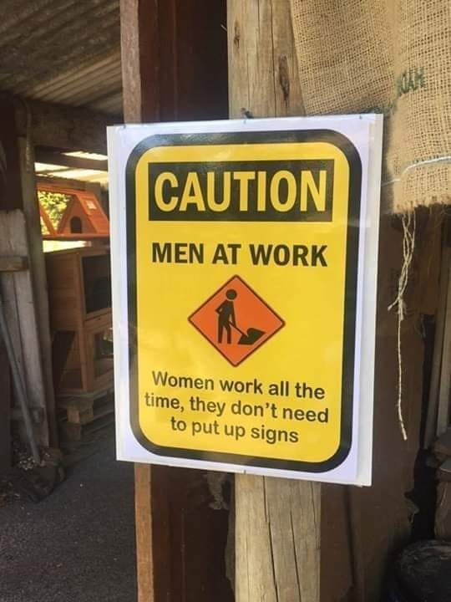

Slide 29
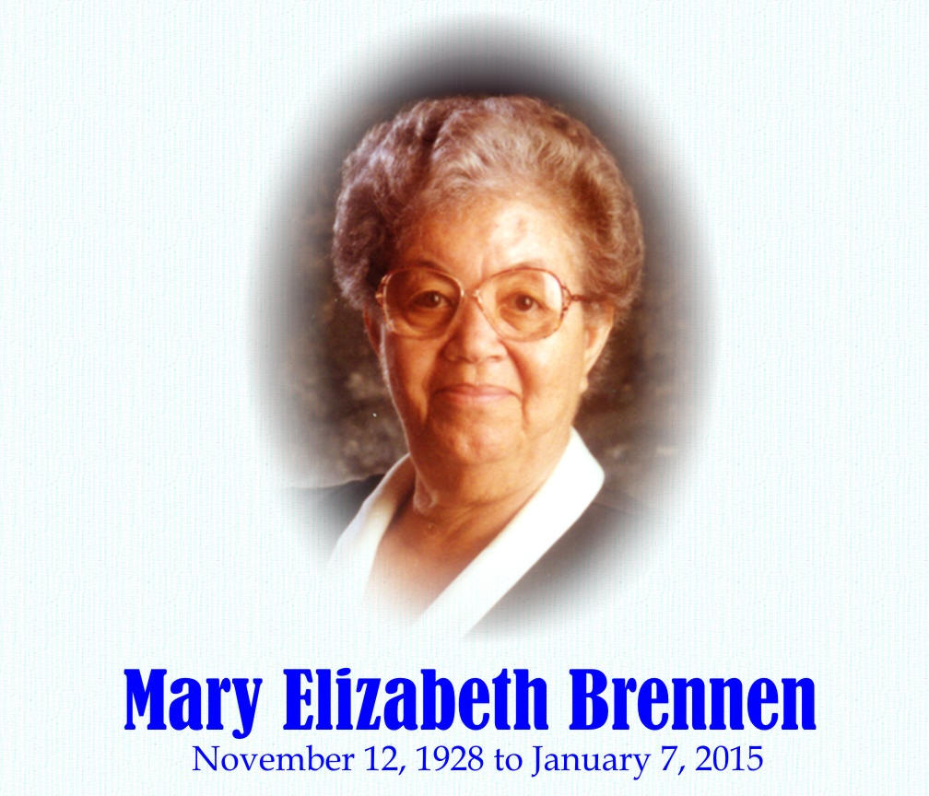
My mother taught me how to:
Sew
Knit
Pom Pom
Crochet
Cook
Bake bread
Cut paper straight
Write neatly
Decorate
Smile
Make cottage cheese, apple and raisin salad.
Boil and fry egg
Handle a sewing machine
How to hem
How to make pigeon peas patty

Slide 30
Motherhood through the ages.

Slide 31
Genesis 1:27-28 NIV
So God created mankind in his own image, in the image of God he created them; male and female he created them.

Slide 32
Genesis 1:27-28 NIV
²⁸ God blessed them and said to them, “Be fruitful and increase in number; fill the earth and subdue it. Rule over the fish in the sea and the birds in the sky and over every living creature that moves on the ground.”

Slide 33
Genesis 1:27-28 NIV
²⁸ God blessed them and said to them, “Be fruitful and increase in number; fill the earth and subdue it. Rule over the fish in the sea and the birds in the sky and over every living creature that moves on the ground.”

Slide 34
1
In the beginning women/mothers were equal with fathers in authority and responsibility.

Slide 35
Genesis 3:14-16
Take your hard bibles or iPads or Smart Phones

Slide 36
2
Mothers were quite cunning and manipulative from the earliest of times.

Slide 37
Genesis 16:3-4
Take your hard bibles or iPads or Smart Phones

Slide 38
2
Mothers were quite cunning and manipulative from the earliest of times.

Slide 39
3
Mothers/women lost the their value and purpose God intended for them

Slide 40
Deuteronomy 22:28-29
Take your hard bibles or iPads or Smart Phones

Slide 41
28. "A man who rapes a maiden, however, (but only if the commission of his crime is witnessed), will pay the victim’s father fifty shekels or silver and then marry her, and never be allowed to divorce her."

Slide 42
Proverbs 31:10-31
Take your hard bibles or iPads or Smart Phones

Slide 43
“Who can find a virtuous wife?
For her worth is far above rubies.”

Slide 44
She was able to:
Own her own property
Go to the bank by herself
Go to college or university
Go to a realtor and purchase property
Go to the grocery store alone
Vote for the politician of her choice

Slide 45
Ephesians 5:22: Wives, submit yourselves unto your own husbands, as unto the Lord.
Ephesians 5:23: For the husband is the head of the wife as Christ is the head of the church, his body, of which he is the Savior.

Slide 46
Adventist Home, chapter 38
“Woman should fill the position which God originally designed for her, as her husband's equal. The world needs mothers who are mothers not merely in name but in every sense of the word. . .

Slide 47
. . . We may safely say that the distinctive duties of woman are more sacred, more holy, than those of man. Let woman realize the sacredness of her work and in the strength and fear of God take up her life mission. Let her educate her children for usefulness in this world and for a home in the better world.”

Slide 48

Confusion

Slide 49
Should I work
or stay at home?

Slide 50
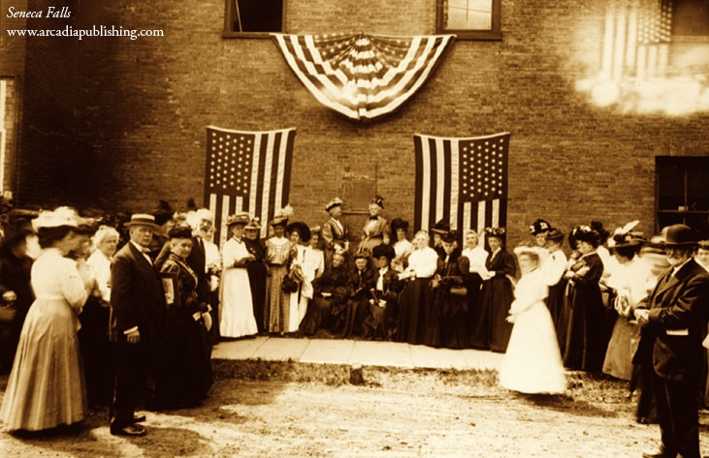
July 19, 1848

Slide 51
Declaration of Sentiments
He has compelled her to submit to laws, in the formation of which she had no voice.
He has withheld from her rights which are given to the most ignorant and degraded men — both native and foreigners.

Slide 52
Declaration of Sentiments
He has made her, if married, in the eyes of the law, civilly dead.
He has denied her the facilities for obtaining a thorough education — all colleges being closed to her.

Slide 53
These mothers:
Protested
Marched
Agitated
To have equal
rights as fathers

Slide 54
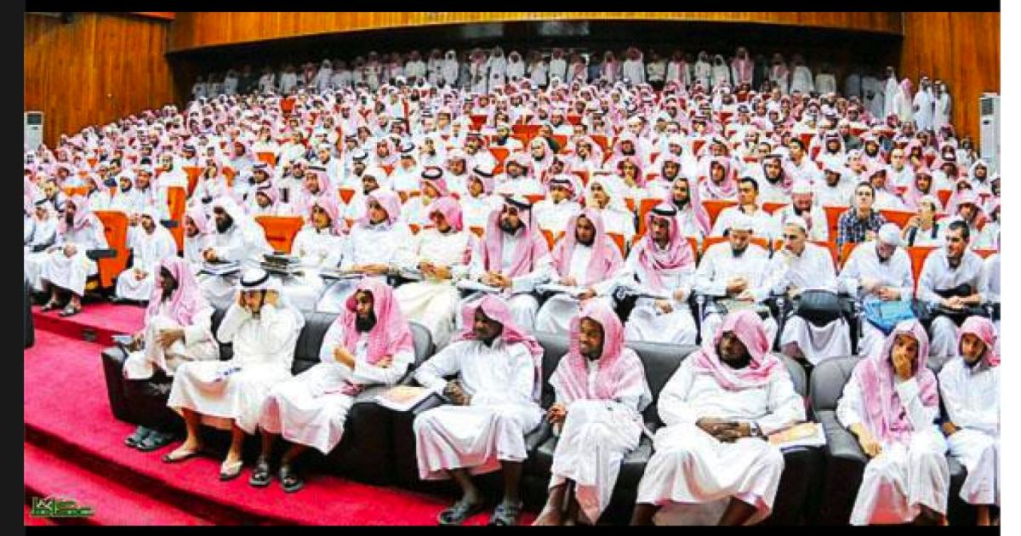

Slide 55
Britain-1918
Dutch-1919
United State-1920
Jamaica-1944
France-1944
Barbados-1951
Ethiopia -955
Haiti-1957
Bahamas-1962
Voting Rights

Slide 56
The greatest honor for mothers is to be the symbol of the true church in the last days.

Slide 57
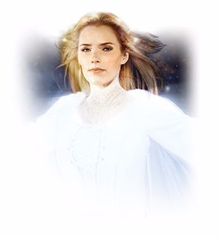
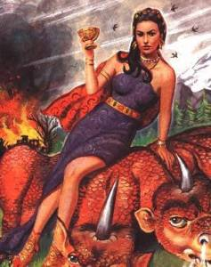

Slide 58
God’s Church

Slide 59
Revelation 12:17
Revelation 17:5-6
Revelation 19:7-9
Revelation 21:9-11

Slide 60
Great is Thy Faithfulness

Slide 61
1
Great is Thy faithfulness, O God my Father;
There is no shadow of turning with Thee;
Thou changest not, Thy compassions, they fail not;
As Thou hast been, Thou forever will be.

Slide 62
Refrain
Great is Thy faithfulness!
Great is Thy faithfulness!
Morning by morning new mercies I see.
All I have needed Thy hand hath provided;
Great is Thy faithfulness, Lord, unto me!

Slide 63
2
Summer and winter and springtime and harvest,
Sun, moon and stars in their courses above
Join with all nature in manifold witness
To Thy great faithfulness, mercy and love.

Slide 64
Refrain
Great is Thy faithfulness!
Great is Thy faithfulness!
Morning by morning new mercies I see.
All I have needed Thy hand hath provided;
Great is Thy faithfulness, Lord, unto me!

Slide 65
3
Pardon for sin and a peace that endureth
Thine own dear presence to cheer and to guide;
Strength for today and bright hope for tomorrow,
Blessings all mine, with ten thousand beside!

Slide 66
Refrain
Great is Thy faithfulness!
Great is Thy faithfulness!
Morning by morning new mercies I see.
All I have needed Thy hand hath provided;
Great is Thy faithfulness, Lord, unto me!

Slide 67
Great is Thy Faithfulness

Slide 68
Our
Dearest
Mothers

